Slide 1
To FUSE or Not To FUSE: Performance of User-Space File Systems
Bharath Kumar Reddy Vangoor, Vasily Tarasov, Erez Zadok
In 2017 USENIX Conference on File and storage Technologies (FAST ’17)
2021. 03. 17
Presentation by Han, Yejin
hyj0225@dankook.ac.kr

Slide 2
Introduction
Motivation
FUSE
StackFS
Evaluation
Conclusion

Slide 3






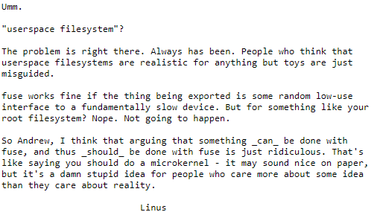
1. Introduction
Controversy on Userspace file system
…
파일시스템 개발하기 쉽구먼~
Notes:
일반적으로 파일시스템은 커널단에서 구현하는데 유저스페이스단에서 파일시스템을 구현하는 것에 대해 여러 의견이 나뉩니다.

Slide 4
2. Motivation
User-space file systems
Development Ease
Portability
Libraries
Existing Code and User Base
?
performance overhead
Notes:
FUSE fs은 user-level fs이기에 많은 context switch와 kerner/user mode switc가 일어난다.+kernel memor와 user buffer 사이에 복사도 계속.

Slide 5
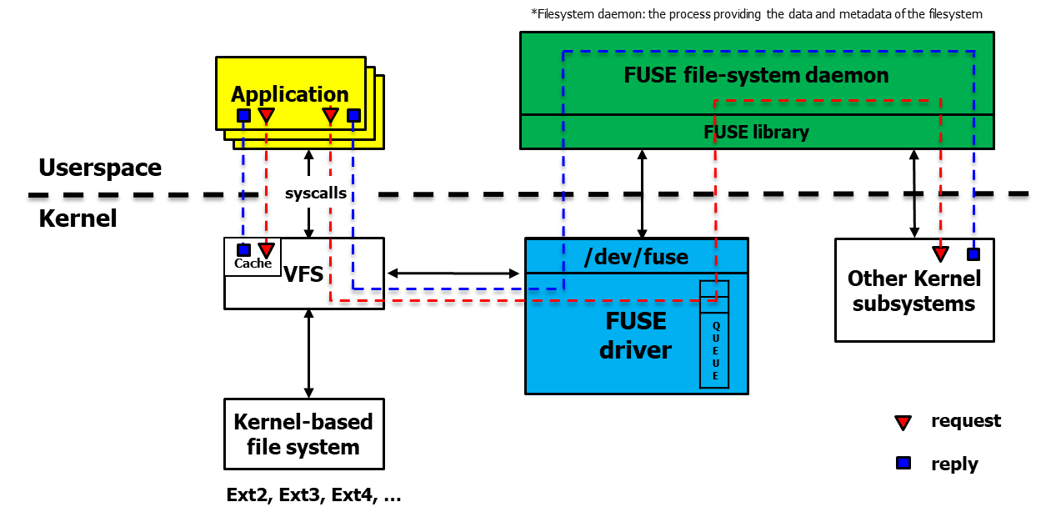

3. FUSE
FUSE high-level architecture
Linux kernel module(fuse.ko), FUSE driver, User-space daemon

Slide 6
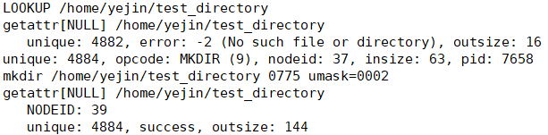
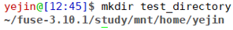
3. FUSE
FUSE high-level architecture
Linux kernel module(fuse.ko), FUSE driver, User-space daemon

Slide 7
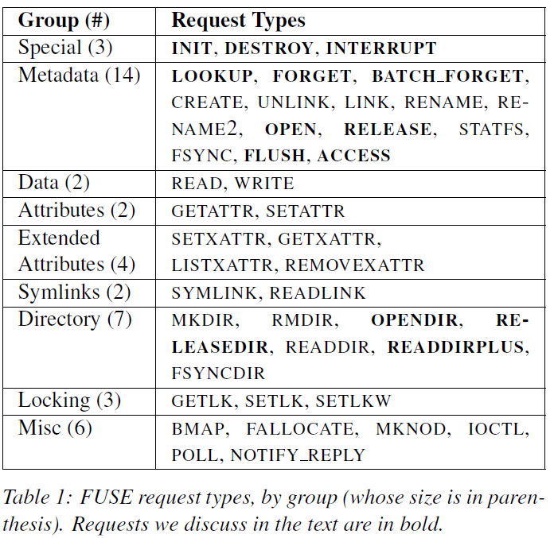
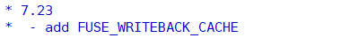
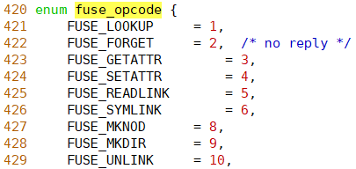
3. FUSE
FUSE Request
User-kernel protocol, Request types
Linux Kernel: include/uapi/linux/fuse.h
User level lib: include/fuse_kernel.h
…
…
Notes:
Init -mount될 때 protocol
Destroy - unmount
Interrupt- 이전 요청이 더 이상 필요하지 않을때( unique num)
Metadata: node ID-> inode indentify하기 위해 필요
lookup- path에서 inode로 translation 수행
Forget- data cache로부터 inode 제거할때 kerne이 데몬에게 요청보내면 데몬은 그에 맞는 데이터구조 할당 해제함.
Batchforget은 한번의 요청으로 다수의 inode 제거할때 보냄

Slide 8
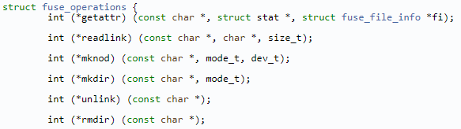
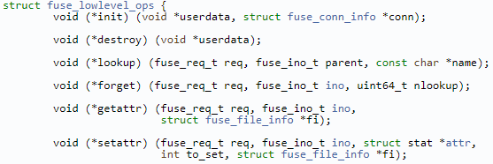
3. FUSE
FUSE API levels
High-level vs. Low level API
High-level API
Low-level API
…
…
Skip the path-to inode mapping
work with file names and paths instead of inodes
Development ease
Receiving and parsing requests from the kernel
work with inodes
High flexibility

Slide 9
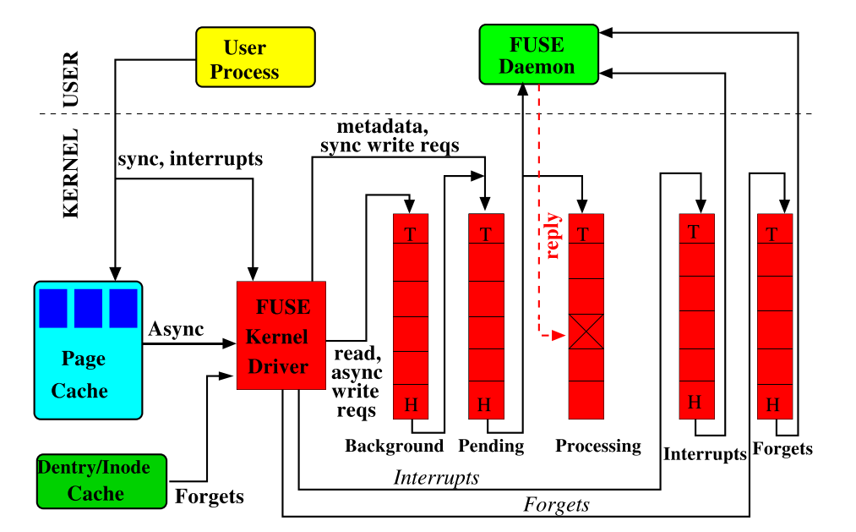

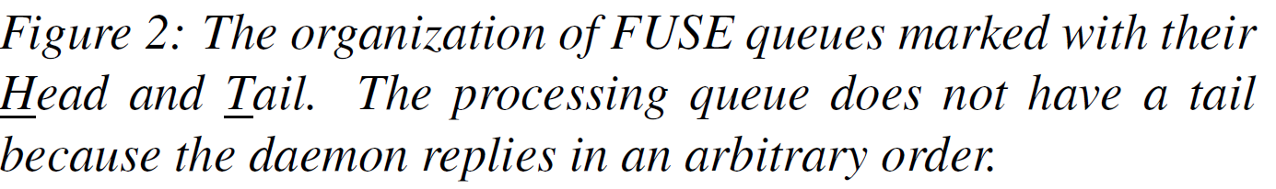
3. FUSE
FUSE Queues
Interrups, forgets, pending, processing, background
Notes:
5개의 큐 설명
Fuse kernel driver 내부에서 request가 관리되는 큐

Slide 10


3. FUSE
FUSE Optimizations
Zero copy using Splicing
/dev/fuse read()/write() requires a memory copy between the kernel and user space.
Since they often process a lot of data, FUSE use splicing functionality.
transfer data without copying the data
Multi-threaded daemon
If there are more requests in the pending queue, FUSE spawns additional threads.
Every thread processes one request at a time.
After processing the request, each thread checks if there are more than 10 threads running;
If so, that thread exits.
10
Notes:
FUSE 데몬이 /dev/fuse로부터 요청을 읽어서 처리하고 응답을 보내는 건 kernel과 user 사이에 메모리 복사가 필요하다. But 많은 데이터를 읽고 써야하기때문에 splicing을 도입함. Splice()는 두개의 파일디스크립터간에 커널 address space와 user address space간의 복사를 하지 않고 데이터를 복사한다.

Slide 11
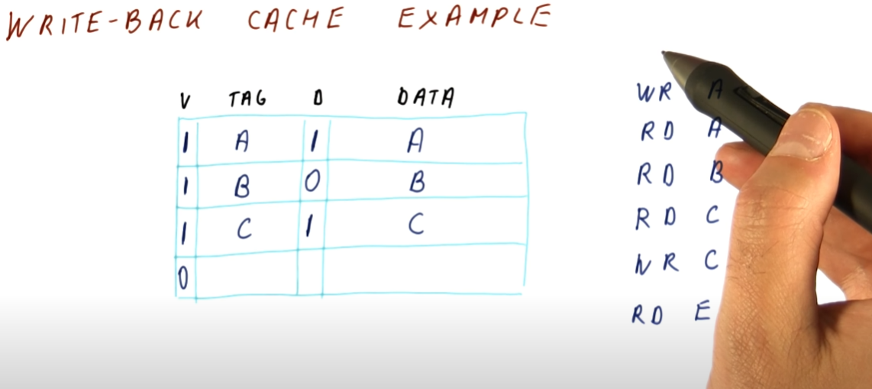
3. FUSE
FUSE Optimizations
Write-back cache
The basic write behavior of FUSE is synchronous and only 4KB of data is sent to the user daemon.
When copying a large file, it can result in performance problems.
So FUSE support a write-back policy and make writes asynchronous.
File data can be pushed to the user daemon in larger chunks.
11
Notes:
Memory mapped I/O mmap I/O

Slide 12

4. StackFS
StackFS
Stackable passthrough file system using FUSE’s low-level API
StackFS layers on top of an Ext4 file systems
StackFS passes FUSE requests directly to the Ext4
StackFS
Ext4
https://github.com/sbu-fsl/fuse-stackfs
Notes:
DRAM과 PCM, NAND간의 속도차이가 몇배가 나는지 설명

Slide 13
5. Evaluation
Evaluation Environment
CPU | Intel Xeon CPU E5530 4 core 2.40GHz processor
Memory | 4 GB RAM
OS | 64-bit Linux 3.14
Filesystem | Ext4 / *StackfsBase / *StackfsOpt
Device | 200GB Intel X25-M SSD/ 146GB Seagate Savvio 15K.2 15KRPM HDD
Workload | Sequential/random-read/write-N threads-M files
*StackfsBase: with no major FUSE optimizations
*StackfsOpt: with all FUSE improvements
(write-back cache, increased size of request, multi-threaded, splicing)

Slide 14
5. Evaluation
Performance Observation
The Relative difference varied across workloads, devices, and FUSE configurations
FUSE’s optimizations improve performance significantly

Slide 15
5. Evaluation
Performance Observation
But optimizations can degrade the performance on other workloads.
Only two file-create workloads fell into the red group (50%↑ degration)

Slide 16
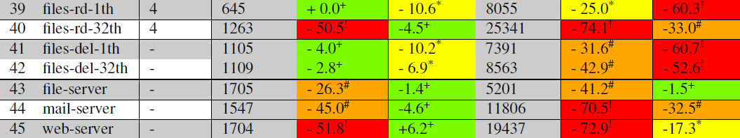
5. Evaluation
Performance Observation
Performance depends significantly on the underlying device.
Stackfs performs visibly worse for metadata-intensive and macro workloads
(especially low for SSDs)

Slide 17
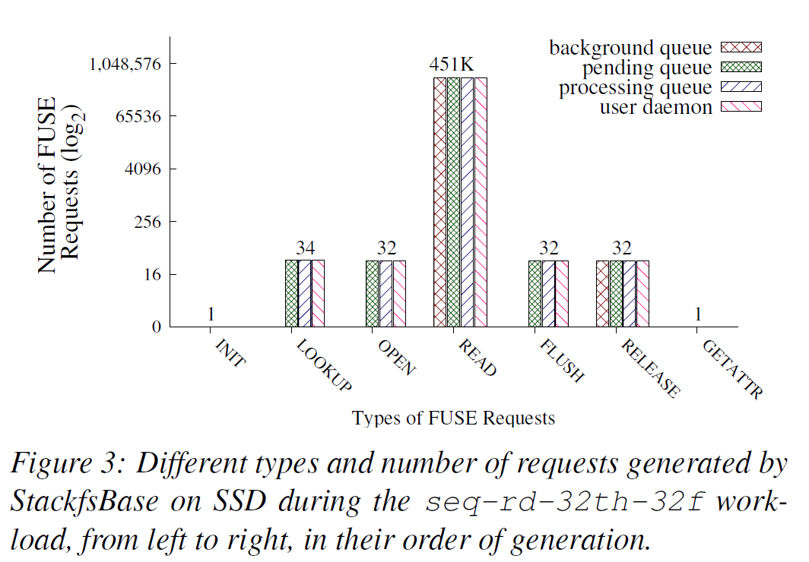
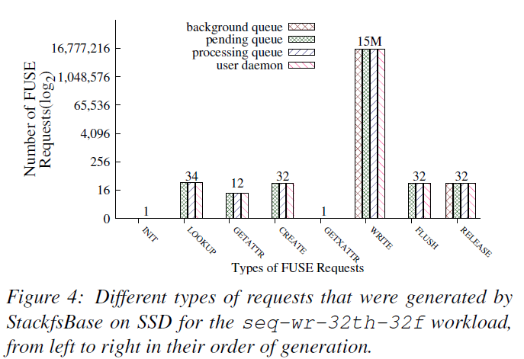
5. Evaluation
workloads
Read workloads
Write workloads

Slide 18
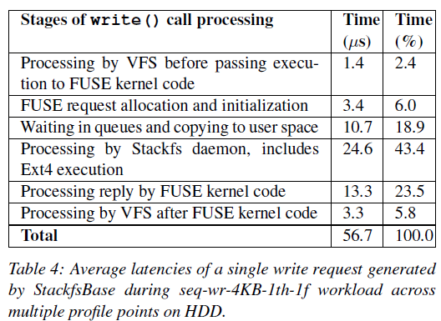
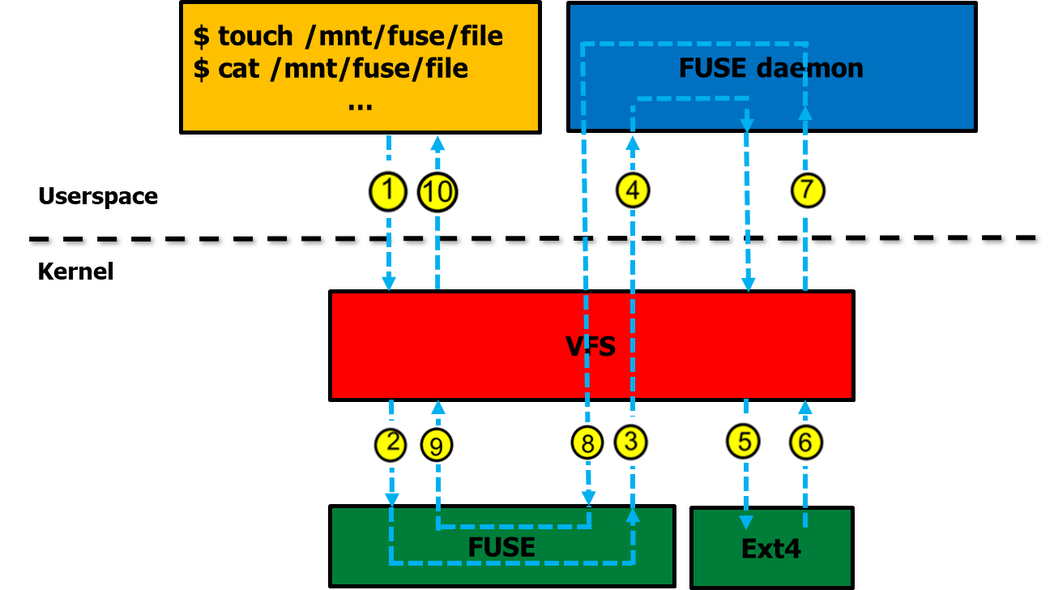
5. Evaluation
Performance tracing points

Slide 19
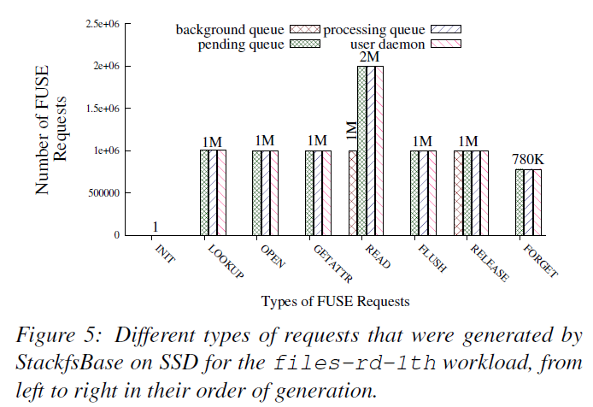
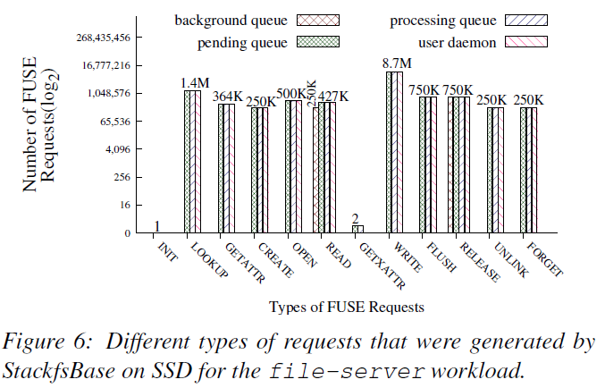
5. Evaluation
Metadata workloads
Macro server workloads

Slide 20
6. Conclusion
FUSE is one of the most popular user-space file system frameworks
In-depth performance analysis of FUSE performance
Depending on the workload/hardware, FUSE performance degration can be imperceptible or as high as -83%

Slide 21
To FUSE or Not To FUSE: Performance of User-Space File Systems
Bharath Kumar Reddy Vangoor, Vasily Tarasov, Erez Zadok
In 2017 USENIX Conference on File and storage Technologies (FAST ’17)
Thank You!
2021. 03. 17
Presentation by Han, Yejin
hyj0225@dankook.ac.kr
Notes:
Let me begin my presentation.
Today I will give a presentation on “Fully Automatic Stream Management for Multi-Streamed SSDs Using Program Contexts”

